Slide 1
Pointers
Lecture 5

Slide 2
Error Types Reminder
Don’t forget the different error types when coding.
Debugging is an absolute necessity when coding and even more so when coding pointers, so discussing this briefly here is appropriate.
There are five types of coding error:
  Syntax errors are those that prevent your code from compiling because of incorrect use of language grammar.
  Semantic errors are errors in meaning. For example, if you have an apple object and you try to add to an orange object. Much more common ones are when you try to assign a float value to an integer variable. These can also be called type errors.
  When your code compiles and your program runs as planned, but the output is incorrect, you have a logic error. That is why you need a test plan! And why you actually run through it!
  When your program crashes it is a run-time error.
  Finally if the input data is incorrect in some way, then your output will be incorrect also: a GIGO error.

Slide 3
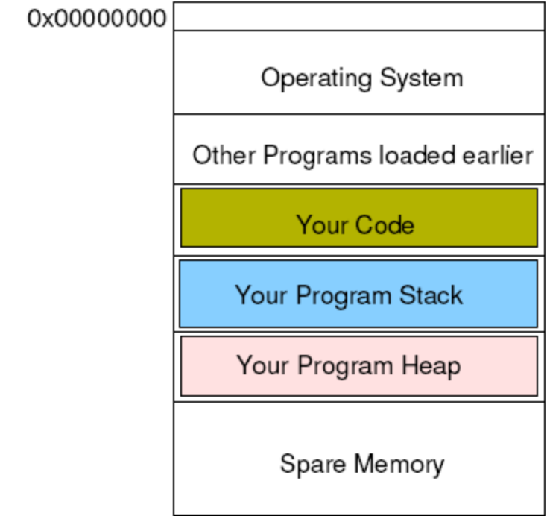
RAM
When your program runs, the OS allocates RAM for its use. [1]
This RAM is divided up into different sections for use in different ways by your program. The layout shown below can be different for different architectures and OS.
The program stack stores variables, parameters etc. that are defined when you write your program.
The program heap is used for memory locations that are defined as your program runs: dynamically allocated variables.
Notes:
[1] The diagram shown is one example. There are other arrangements.

Slide 4
Pointers
Pointers cause more heartache than is really necessary.
All they are is a variable that stores the address of another variable.
Of course it is also possible to continue this ad-infinitum, which means that you can end up with an address, of an address, of an address...
But in actually fact it is rare that you go beyond one, or two, levels of dereference.

Slide 5
Declaring Pointers
 | 0x00000000
 |  | ...
 |  | Your program stack
 | ptr
 |  | Your program heap
This declares a pointer to an integer sized memory location.
It does not allocate the memory location for you to store the actual data.
int *ptr;

Slide 6
Declaring Pointers
 | 0x00000000
 |  | ...
 |  | Your program stack
 | ptr | ??
 |  | Your program heap
This means that trying to use the memory location contained in the pointer variable will crash the program or cause strange events.
This is because the contents of ptr could be anything; i.e. it could be pointing anywhere in memory.
??
int *ptr;

Slide 7
Declaring Pointers Safely
 | 0x00000000 | 0
 |  | ...
 |  | Your program stack
 | ptr | 0x00000000
 |  | Your program heap
To prevent accidental alteration of anything important, pointers should always be initialised to NULL.
The zero^{th} memory location is kept empty for this reason.
int *ptr = NULL;

Slide 8
Allocating Memory
 | 0x00000000 | 0
 |  | ...
 |  | Your program stack
 | ptr | 0xaf556808
 | 0xaf556808
 |  | Your program heap
The allocation of memory is then done with the new keyword.
This allocates a memory location on the heap of the given size (in this case an int).
int *ptr = NULL;
ptr = new int;

Slide 9
Using Pointers
 | 0x00000000 | 0
 |  | ...
 |  | Your program stack
 | ptr | 0xaf556808
 | 0xaf556808 | 345
 |  | Your program heap
To place a value in the memory location, the * dereferencing operator is used.
int *ptr = NULL;
ptr = new int;
*ptr = 345;

Slide 10
Using Pointers
 | 0x00000000 | 0
 |  | ...
 |  | Your program stack
 | ptr | 0xaf556808
 | 0xaf556808 | 345
 |  | Your program heap
This is also used for accessing the location for output etc.
int *ptr = NULL;
ptr = new int;
*ptr = 345;
cout << *ptr << endl;

Slide 11
Where is the Pointer Pointing?
 | 0x00000000 | 0
 |  | ...
 |  | Your program stack
 | ptr | 0xaf556808
 | 0xaf556808 | 345
 |  | Your program heap
You could also output the location of the memory being used, rather than the contents of the memory location.
int *ptr = NULL;
ptr = new int;
*ptr = 345;
cout << ptr << endl;

Slide 12
Releasing Memory
 | 0x00000000 | 0
 |  | ...
 |  | Your program stack
 | ptr | 0xaf556808
 | 0xaf556808 | 345
 |  | Your program heap
Every new must have a matching delete, so that memory is released back to the OS.
int *ptr = NULL;
ptr = new int;
...
delete ptr;

Slide 13
Releasing Memory Safely
 | 0x00000000 | 0
 |  | ...
 |  | Your program stack
 | ptr | 0x00000000
 | 0xaf556808 | 345
 |  | Your program heap
Followed, of course, by reassigning the pointer to NULL, so that it does not point to memory over which it no longer should have control.
int *ptr = NULL;
ptr = new int;
...
delete ptr;
ptr = NULL;

Slide 14
Pointing at Other Variables
 | 0x00000000 | 0
 |  | ...
 |  | Your program stack
 | num | 10
 | ptr | 0x00000000
 |  | Your program heap
Pointers can also point at other variables:
int *ptr = NULL;
int num = 10;

Slide 15
Pointing at Other Variables
 | 0x00000000 | 0
 |  | ...
 |  | Your program stack
 | num | 10
 | ptr | 0x00000000
 |  | Your program heap
Pointers can also point at other variables.
int *ptr = NULL;
int num = 10;
ptr = &num;

Slide 16
Pointing at Other Variables
 | 0x00000000 | 0
 |  | ...
 |  | Your program stack
 | num | 23
 | ptr | 0xacf56124
 |  | Your program heap
And change their value.
int *ptr = NULL;
int num = 10;
ptr = &num;
*ptr = 23;

Slide 17
Memory Leaks
 | 0x00000000 | 0
 |  | ...
 |  | Your program stack
 | ptr | 0xaf55721f
 | num | 12
 | 0xaf55721f | 345
 |  | Your program heap
However care must be taken not to cause a memory leak.
int num = 12;
int *ptr = new int;
*ptr = 345;

Slide 18
Memory Leaks
 | 0x00000000 | 0
 |  | ...
 |  | Your program stack
 | ptr | 0xaf556808
 | num | 12
 | 0xaf55721f | 345
 |  | Your program heap
However care must be taken not to cause a memory leak.
int num = 12;
int *ptr = new int;
*ptr = 345;
ptr = &num;

Slide 19
Memory Leaks
 | 0x00000000 | 0
 |  | ...
 |  | Your program stack
 | ptr | 0xaf556808
 | num | 12
 | 0xaf55721f | 345
 |  | Your program heap
The circled memory location is ‘lost’ until the program ends.
int num = 12;
int *ptr = new int;
*ptr = 345;
ptr = &num;

Slide 20
Avoiding Memory Leaks
 | 0x00000000 | 0
 |  | ...
 |  | Your program stack
 | ptr | 0xaf556808
 | num | 12
 | 0xaf55721f | 345
 |  | Your program heap
Of course, there should have been a delete between the last two lines of code.
This releases the memory back to the OS again.
int num = 12;
int *ptr = new int;
*ptr = 345;
delete ptr;
ptr = &num;

Slide 21
Care with delete
 | 0x00000000 | 0
 |  | ...
 |  | Your program stack
 | ptr | 0xaf556808
 | num | 12
 | 0xaf55721f | 345
 |  | Your program heap
But beware where you put it: trying to delete stack memory will cause trouble.
int num = 12;
int *ptr = new int;
*ptr = 345;
ptr = &num;
delete ptr;

Slide 22
Uses of Pointers
There are two main uses for pointers.
The first is for array and string access.
The second is where pointers are used to create lists or trees: data structures where the next piece of data can only be found by traversing a link from the last piece:

Slide 23
Malik: Chapter on Pointer - exercises
2. Given the declaration:
int x;
int *p;
int *q;
Mark the following statements as valid or invalid.
If a statement is invalid, explain why:
a. p = q;
b. *p = 56;
c. p = x;
d. *p = *q;
e. q = &x;
f. *p = q;

Slide 24
3. What is the output of the following C++ code?
int x;
int y;
int *p = &x;
int *q = &y;
*p = 35;
*q = 98;
*p = *q;
cout « x « " " « y « endl;
cout « *p « " " « *q « endl;

Slide 25
4. What is the output of the following C++ code?
int x;
int y;
int *p = &x;
int *q = &y;
x = 35;
y = 46;
p = q;
*p = 18;
cout « x « " " « y « endl;
cout « *p « " " « *q « endl;

Slide 26
Readings
Textbook (by Malik): Chapter on Pointers, Classes, .. etc. See subsections on Pointer Data Type and Pointer Variables; Address of operator; Dereferencing operator. A different edition may have a different chapter number and pages.
101 Coding Standards: Currently, only if interested: Page 94. It is one of the important references (see unit outline) we use in the unit. See 101 C++ Coding Standards online resource.
Watch the videos on pointers “Video Lecture on Pointers.htm” Function pointers are covered when we cover the tree data structure later on.

